Slide 1

SO YOU THINK YOU CAN
FReeLance

Slide 2

Agenda
Tips for freelancing
How to become a freelance tester
Building your reputation
How to make money as a freelancer

Slide 3
Why Freelancing?
Earn extra income
Gain additional experience
Be your own boss

Slide 4

Earn Extra Income
Notes:
You can earn up to $500 before having to report it to the IRS
As you gain experience and build your reputation, you can earn more money.
You can earn up to $35/hr. on some sites.
Some freelance sites offer the opportunity to become employees.

Slide 5
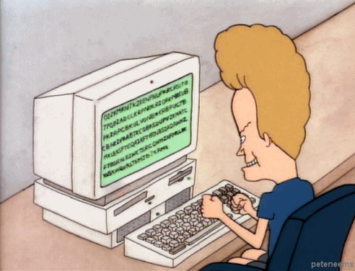
Gain Additional Experience
Notes:
- Work on fun projects
- Work for major brand name companies
- Learn new things

Slide 6

Be Your Own Boss
Notes:
Set your own schedule
Work at your own pace
Work wherever you want—home office, kitchen table, coffee shop, or from your own bed

Slide 7
Tips for Being Successful
Manage Your Time Efficiently
Treat Yourself Right
Expect Rejection
Source: http://www.inc.com/jordan-kasteler/7-freelance-habits-you-should-develop-before-quitting-your-day-job.html
Notes:
Manage Your Time Efficiently: The most common habit successful freelancers develop is the ability to manage their time effectively. Find a tactic that works for you, and then use it as often as you may need, as long as it helps you manage your time.
Treat Yourself Right: There is always work to do. But forgetting that you're only human will lead to a mental break. So, don't forget to take breaks. Give yourself a day or two off periodically. Make sure you get out into the world. Do whatever you need to keep yourself in good spirits and good health.
Don’t Let Rejection Tear You Down: It's best to be prepared for the inevitable when becoming a serious freelancer. Simply being aware that rejection happens is a big first step. Many of these testing projects will have well defined requirements specifying geography (despite being conducted online), particular clients, etc. Keep in mind that your skills have worth, and you'll find a client who sees it as well.

Slide 8
Tips for Being Successful
Take Some Risks
Do Something Fun
Don’t Forget Why You Started
Source: http://www.inc.com/jordan-kasteler/7-freelance-habits-you-should-develop-before-quitting-your-day-job.html
Notes:
4. Take Some Risks: Take on daunting projects. Challenge yourself to learn new things. If you don't go out there and try new things, your career will become stagnant.
5. Have Something Fun to Do: Whether a project for a client or one that you accomplish in your spare time, make sure you're doing something fun. This will help you keep your perspective, remind you why you started, and help you relax even when you're working.
Especially when beginning, freelancers can get caught up doing the same type of projects over and over. Not only is this damaging for a new portfolio, it's also boring and repetitive.
Repetitive jobs become harder to do--just because it's harder to keep focused on them. Make sure to (at least occasionally) take a job that sounds like fun.
6. Don’t Forget Why You Started: Don't forget that you started freelancing not because you had no choice, but because you love it.
In the business that develops, never forget your passion. If you do, it'll be worse than neglecting every other piece of advice out there.
No spark reflects in your work. If you lose your passion and love for your craft, not only will it be hard for you to continue to motivate yourself, but you'll start to put out lower quality work. This can be disastrous--so make sure you take time to remind yourself of your love for your work.

Slide 9
Freelance Testing
uTest – https://www.utest.com/
Testlio – https://testlio.com/
Ubertesters – https://ubertesters.com/
TestFairy - https://testfairy.com/

Slide 10


uTest
Notes:
250,000+ testers
Two options:
Lite user
Full user (for paid projects)
uTest paid out more than $20,000,000 to testers in the past year.

Slide 11
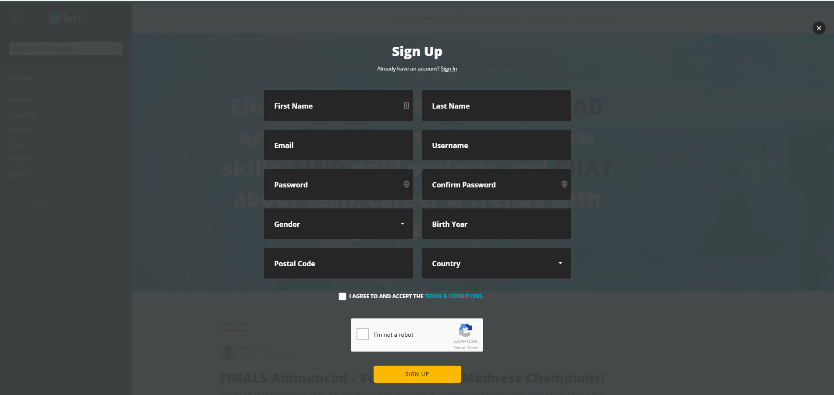
uTest Lite
Notes:
Lite user signup
What is a uTest Lite profile?
A uTest Lite profile gives you access to site features on uTest.com. It means you can:
Comment on blog posts
Rate and review uTest University courses
Rate and review tools
Read and participate in the forums

Slide 12
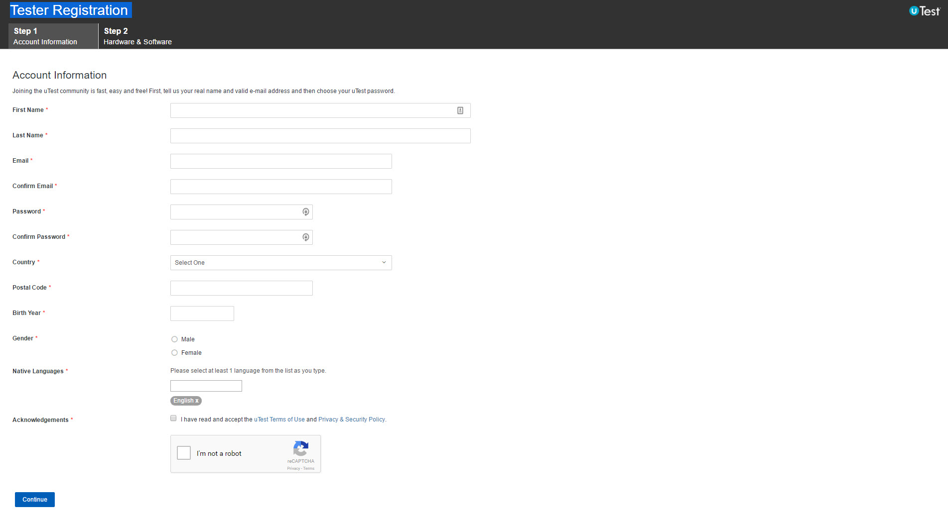
uTest Full user
Notes:
Full user signup
Step 1 – Account Information

Slide 13
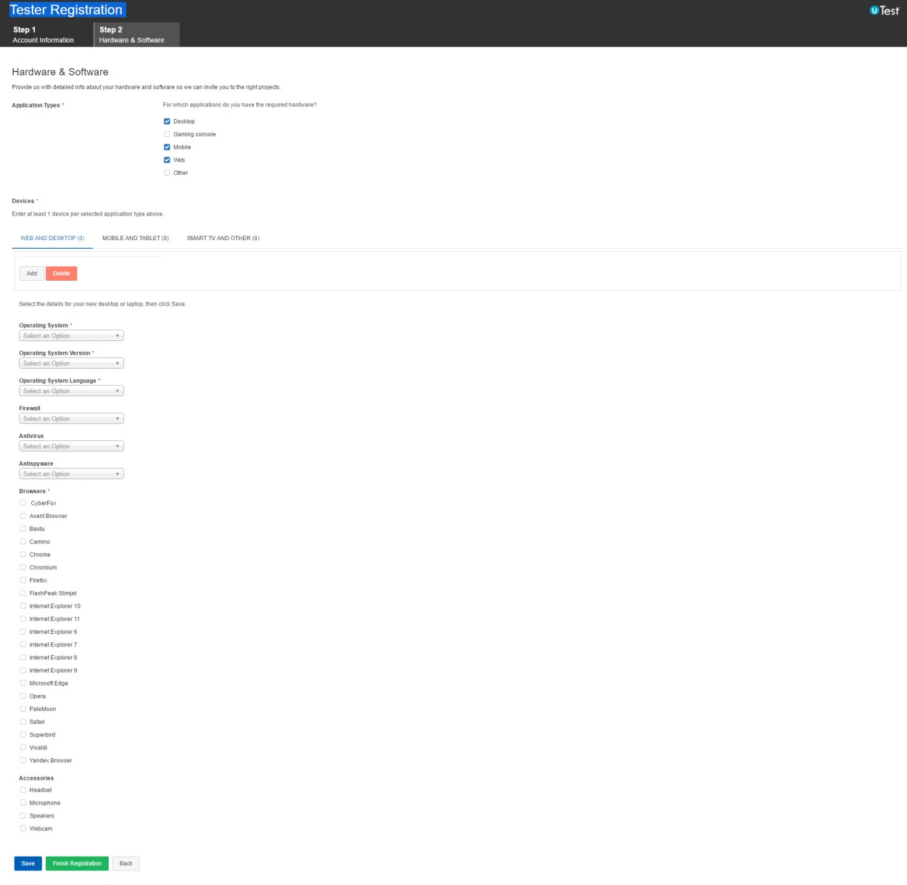
uTest
Notes:
Full user signup
Step 2 – Hardware & Software – WEB AND DESKTOP
Operating System
Operating System Version
Operation System Language
Firewall
Antivirus
Antispyware
Browsers
Accessories
Headset
Microphone
Speakers
Webcam

Slide 14
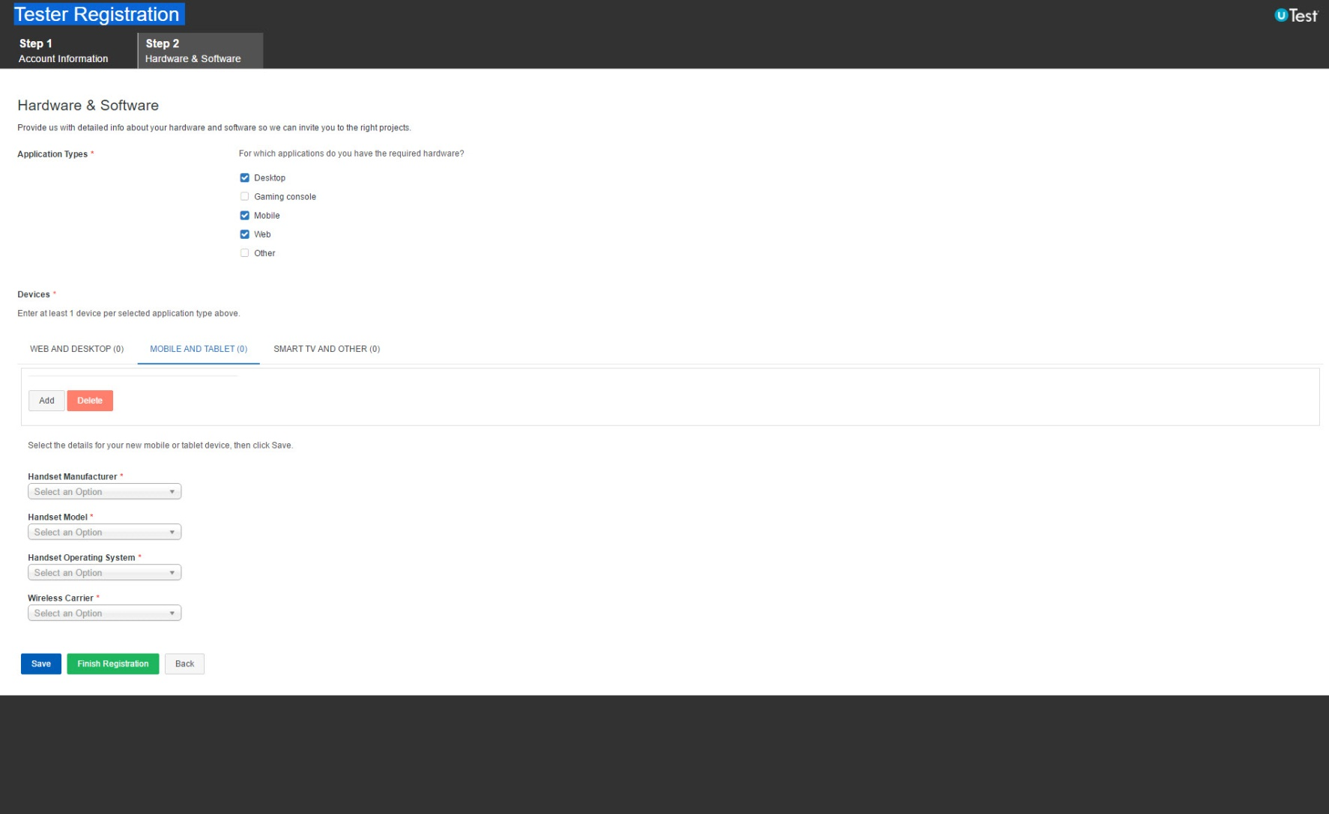
uTest
Notes:
Full user signup
Step 2 – Hardware & Software – MOBILE AND TABLET
Add Devices
Handset Manufacturer
Handset Model
Handset Operation System
Wireless Carrier

Slide 15
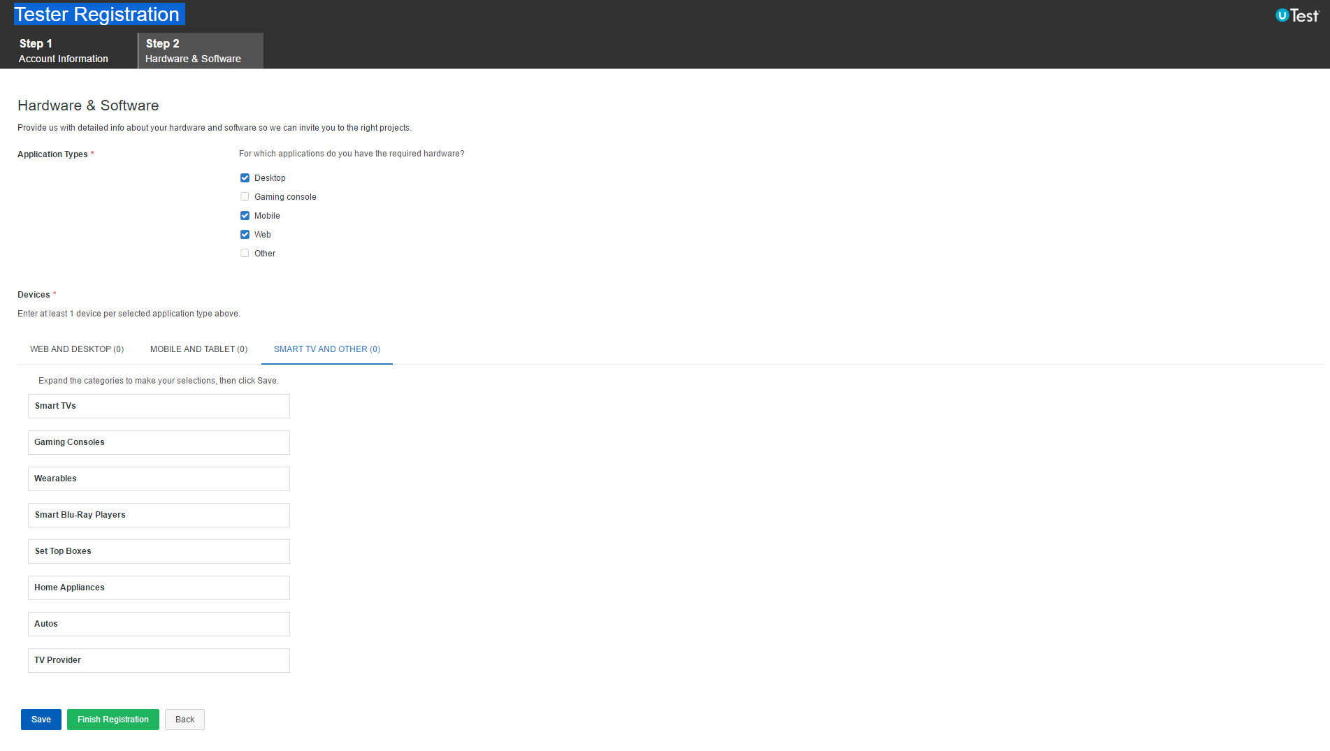
uTest
Notes:
Full user signup
Step 2 – Hardware & Software – SMART TV AND OTHER
Categories
Smart TVs
Gaming Consoles
Wearables
Smart Blu-Ray Players
Set Top Boxes
Home Appliances
Autos
TV Provider

Slide 16
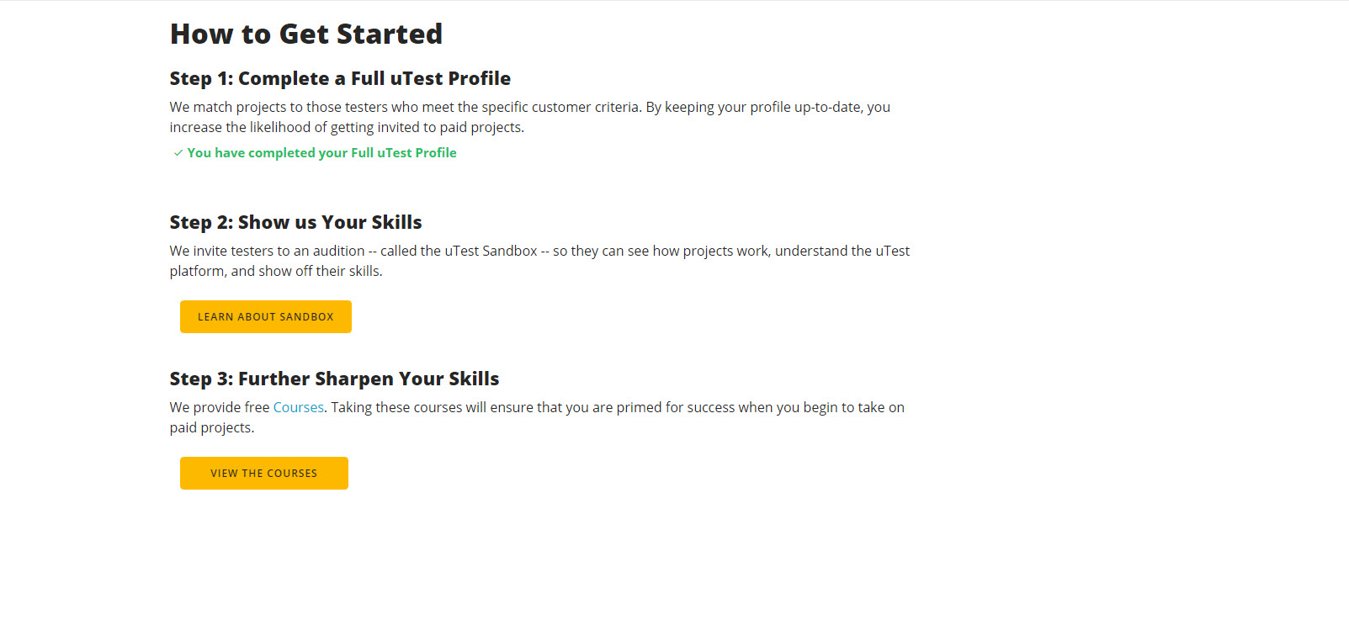
https://www.utest.com/earning-money
uTest
Notes:
How to Get Started - https://www.utest.com/earning-money
Step 1: Complete a Full uTest Profile
We match projects to those testers who meet the specific customer criteria. By keeping your profile up-to-date, you increase the likelihood of getting invited to paid projects.
Step 2: Show us Your Skills
uTest invites testers to an audition -- called the uTest Sandbox -- so they can see how projects work, understand the uTest platform, and show off their skills.
Sandbox 101
The uTest Sandbox 101 is a program that provides newly registered (or currently unrated) uTesters with the opportunity to evaluate uTest, and likewise an opportunity for uTest to evaluate new uTesters. This involves participating in an unpaid “audition” test cycle that closely mimics a regular, paid uTest test cycle.
Step 3: Further Sharpen Your Skills
We provide free Courses. Taking these courses will ensure that you are primed for success when you begin to take on paid projects.

Slide 17
https://www.utest.com/courses/skill-tree
Test Cycle Types
Crowd Sourced Community Test Cycles:
Functional: Exploratory testing and test case completion
Usability: Survey completion
Localization: Translation validation and localization testing
Expert Sourced Community Test Cycles:
Automation: Automated test script creation
Usability: Usability audits, survey creation, survey analysis and expert review
Security: Manual penetration and dynamic security testing
Load and Performance: Script creation and expert review
Notes:
Test Cycle Types
uTest offers several types of testing projects to appeal to many types of software testers.
There’s a section of your profile titled "Testing Settings" where you need to select at least one testing type (outlined above), and a section titled "Hardware & Software" where you must select at least one app type (Mobile, Web, etc). To match you with the best opportunities you are encouraged to select only the testing types you are familiar with or have had some experience in.

Slide 18
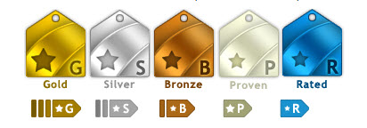
https://www.utest.com/courses/utest-tester-ratings
Tester Ratings
Gold
Silver
Bronze
Proven
Rated
Notes:
How am I rated as a tester?
All testers are rated against other active members of the community based on their quality and activity level (tester rating calculations are performed on a daily basis). There are a total of five tiers for the rated tester: Gold, Silver, Bronze, Proven, and Rated tier (if you do not have a badge, this simply means that you have not filed enough "activity" points). Testers can be Gold in Functional testing, and be lower or even unrated in other testing types.
Gold/Silver/Bronze testers receive higher payout rates than other members of the testing community: Gold testers receive a 10% premium on all approved reports, while Silver and Bronze testers receive a 5% and 2.5% premium, respectively. Payout increases are determined by the rating that applies to the test cycle's testing type.

Slide 19

testlio
What’s Testlio?
Community of testers that help companies make sure their products work
Emphasis on Quality, not Quantity
Impact you have on the end product is what matters
Notes:
What's Testlio?
Testlio is a community of testers that help companies make sure their products work.
Testlio is based in San Francisco and Tallinn, Estonia.
Testlio emphasizes that Quality matters.
Testing shouldn’t be based off of the number of bugs you catch. What matters is the impact you have on the end product. At Testlio, we value the quality of the bugs you find, rather than the quantity.
Get verified - Each tester goes through our verification process to make sure our community is made up of expert testers.
Crush bugs - Once you’ve been verified, you will be invited to a project you can work on around your own schedule.
Get paid - Make up to $35/hr for doing what you love. After each test cycle you will receive payment for the hours you’ve been assigned to test.

Slide 20

https://testlio.com/for-testers/
testlio
How it works:
Get verified
Crush bugs
Get paid
Let’s become a tester…
Notes:
What's Testlio?
Testlio is a community of testers that help companies make sure their products work.
Testlio emphasizes that Quality matters.
Testing shouldn’t be based off of the number of bugs you catch. What matters is the impact you have on the end product. At Testlio, we value the quality of the bugs you find, rather than the quantity.
Get verified - Each tester goes through our verification process to make sure our community is made up of expert testers.
Crush bugs - Once you’ve been verified, you will be invited to a project you can work on around your own schedule.
Get paid - Make up to $35/hr for doing what you love. After each test cycle you will receive payment for the hours you’ve been assigned to test.

Slide 21
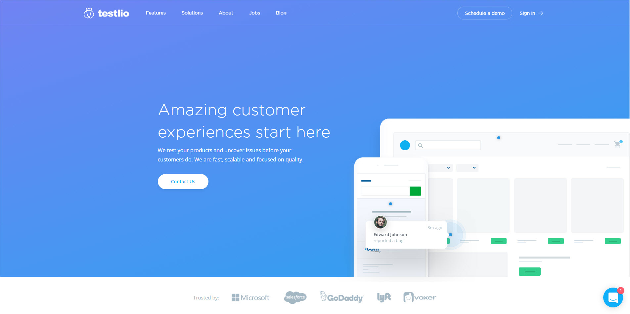
https://platform.testlio.com/tester-faq
testlio
ER BENEFITS
Notes:
Click the “Become a tester” link in the footer under the Community section.

Slide 22
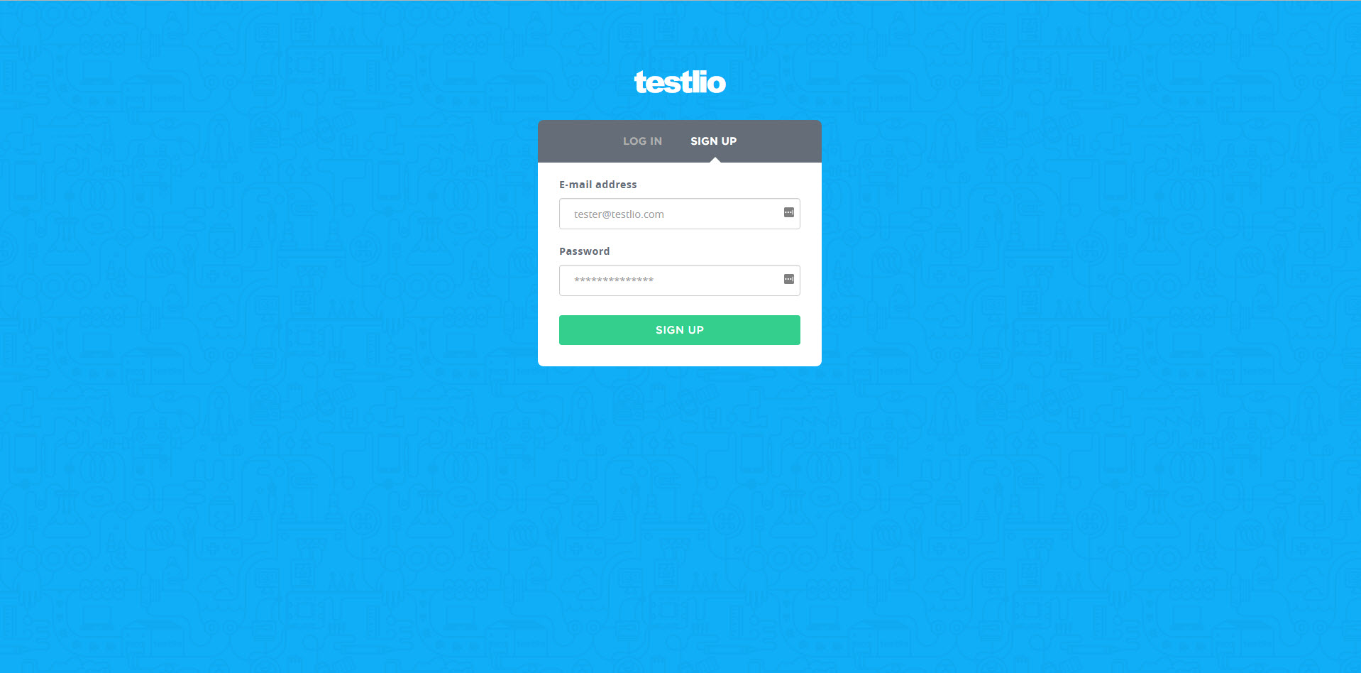
testlio
ER BENEFITS

Slide 23
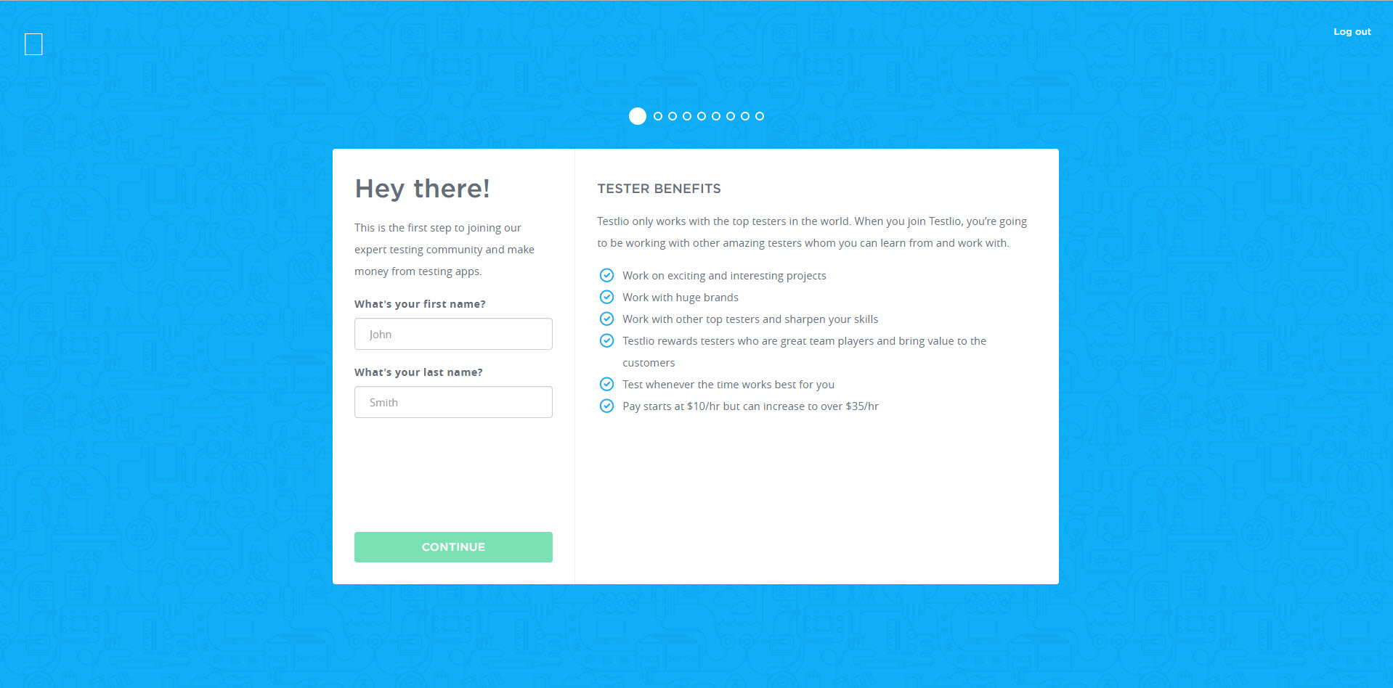
testlio
ER BENEFITS

Slide 24
Tester Benefits
TESTER BENEFITS
Testlio only works with the top testers in the world. When you join Testlio, you’re going to be working with other amazing testers whom you can learn from and work with.
Work on exciting and interesting projects
Work with huge brands
Work with other top testers and sharpen your skills
Testlio rewards testers who are great team players and bring value to the customers
Test whenever the time works best for you
Pay starts at $10/hr but can increase to over $35/hr

Slide 25
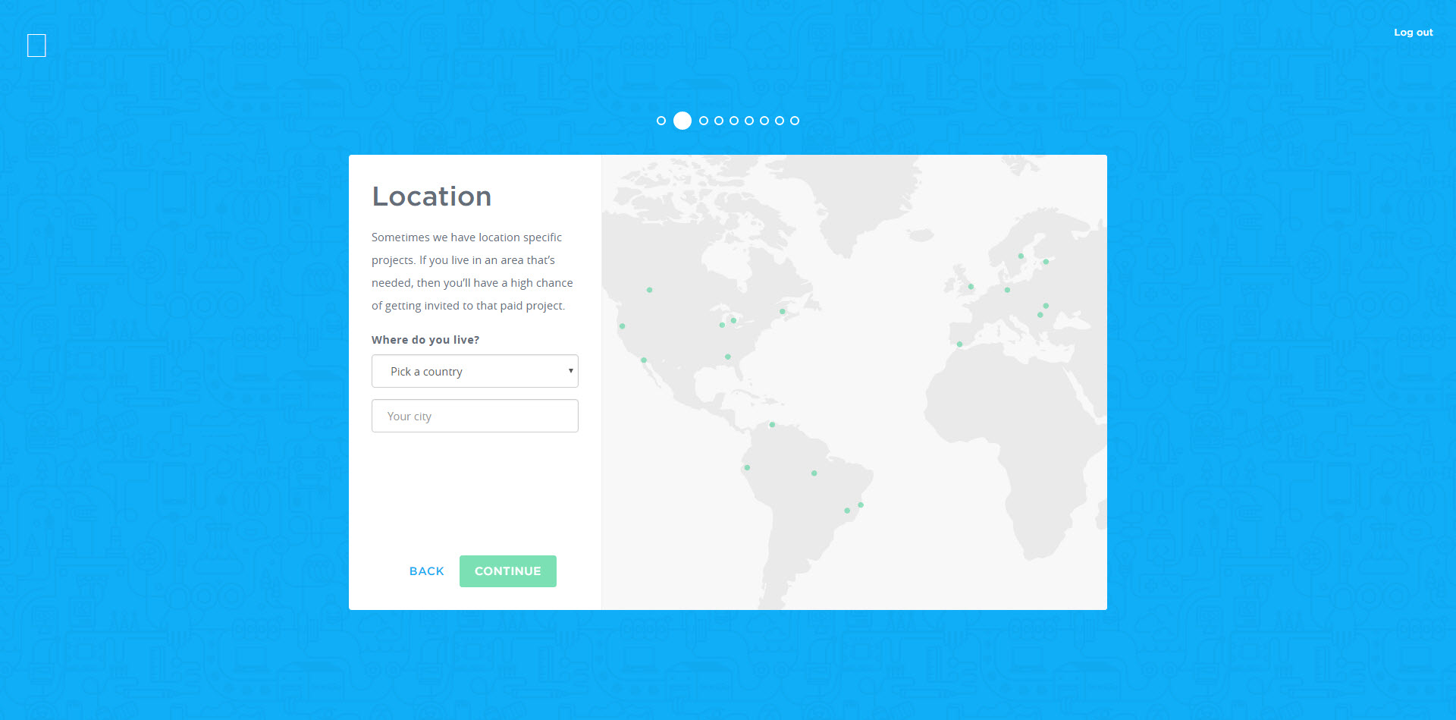
testlio
ER BENEFITS

Slide 26
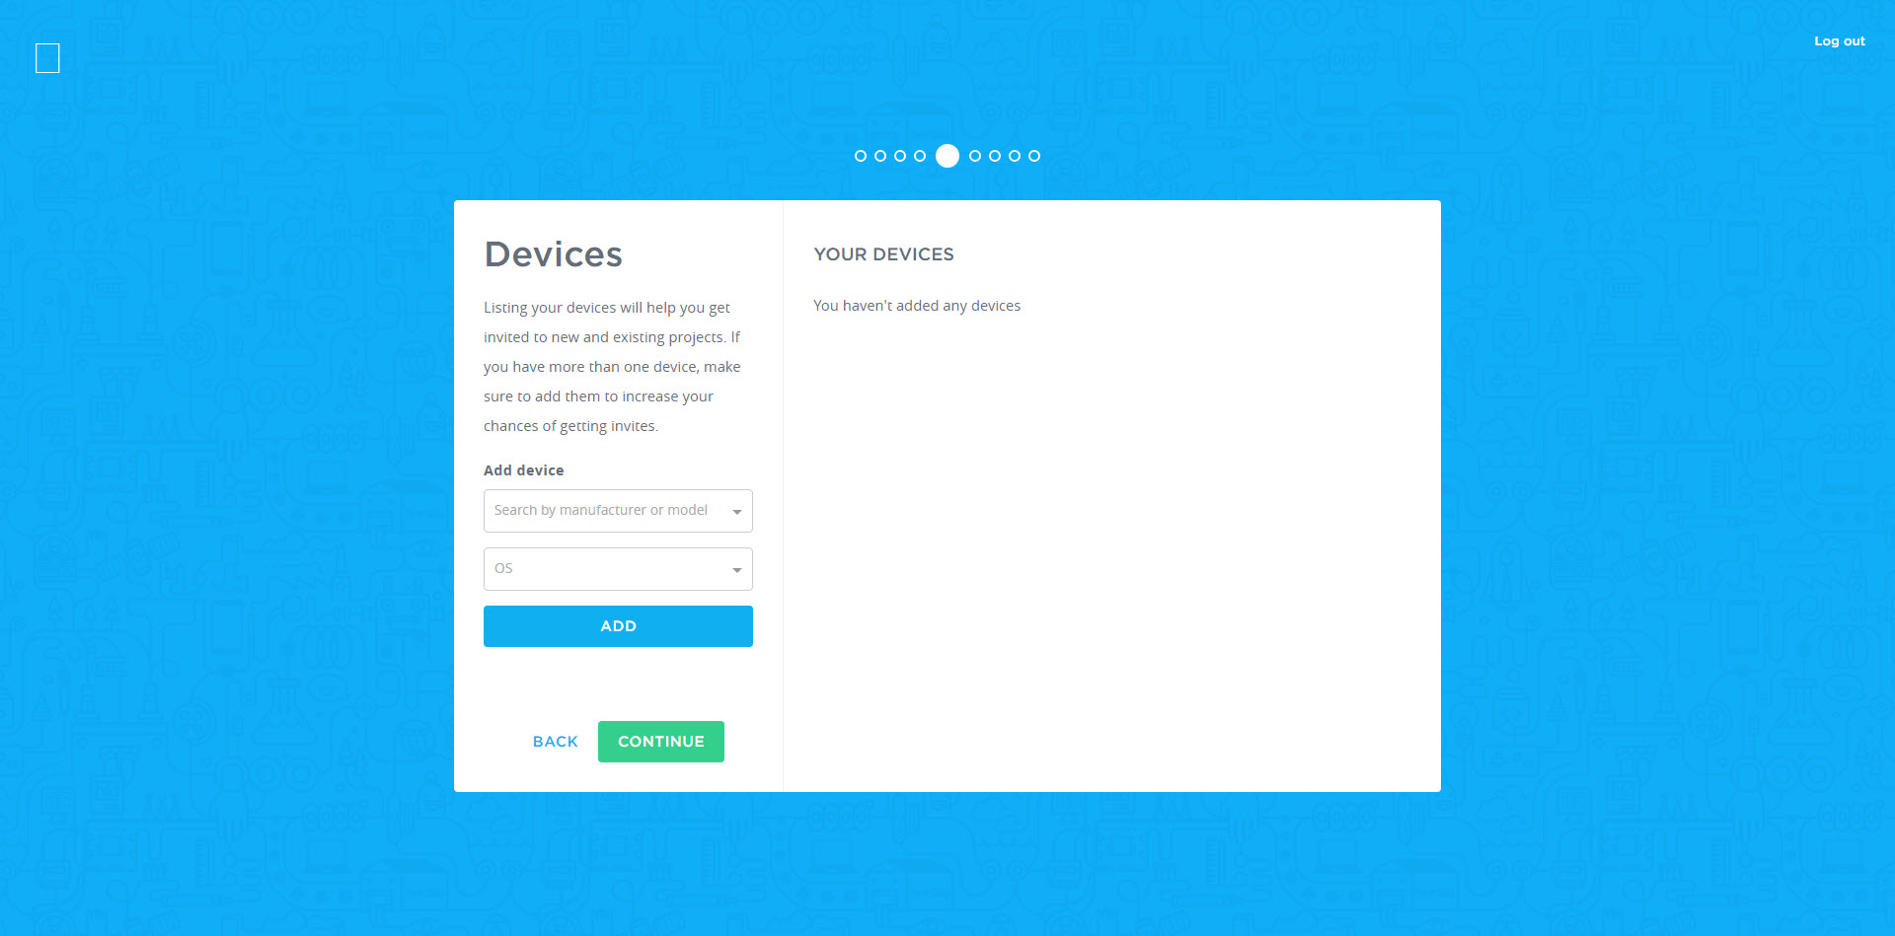
testlio
ER BENEFITS

Slide 27
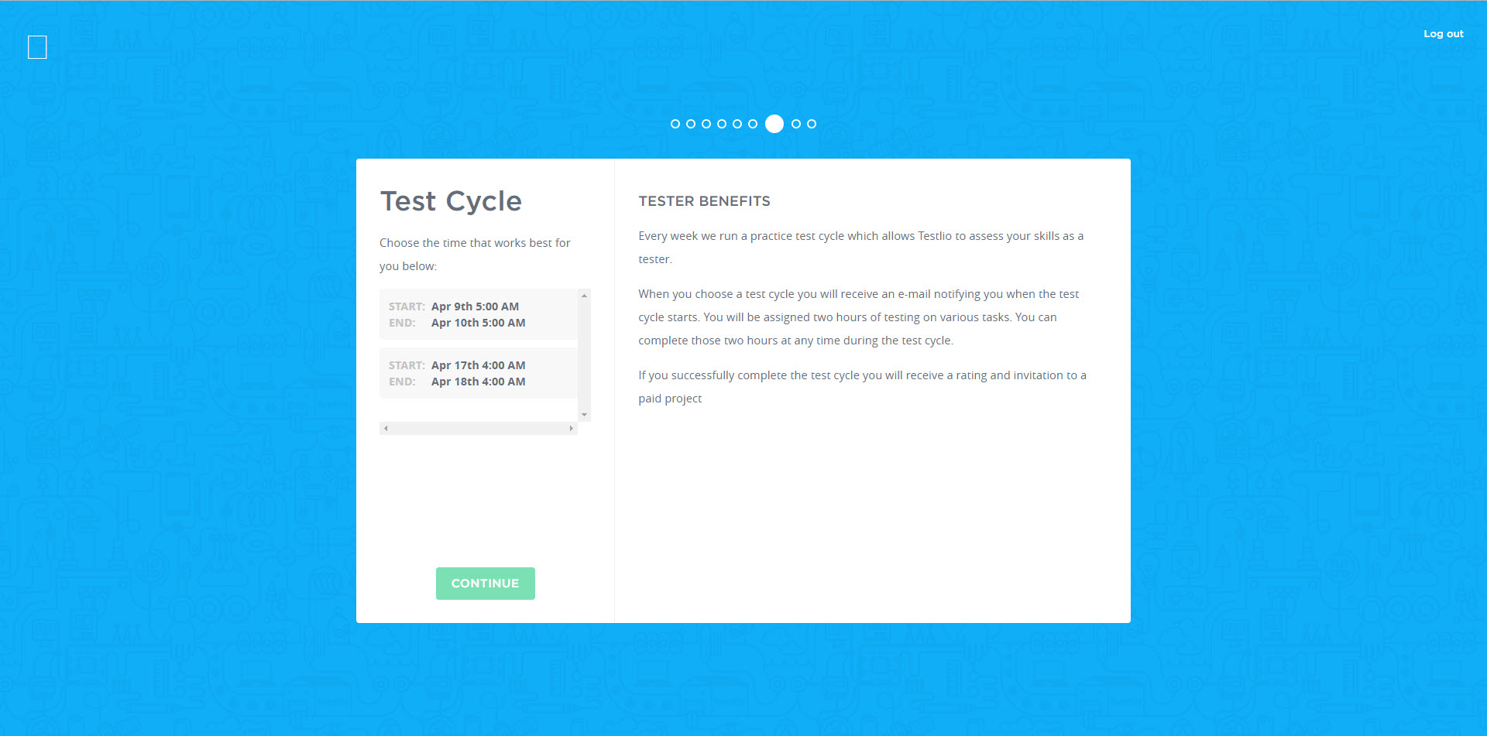
testlio
ER BENEFITS

Slide 28
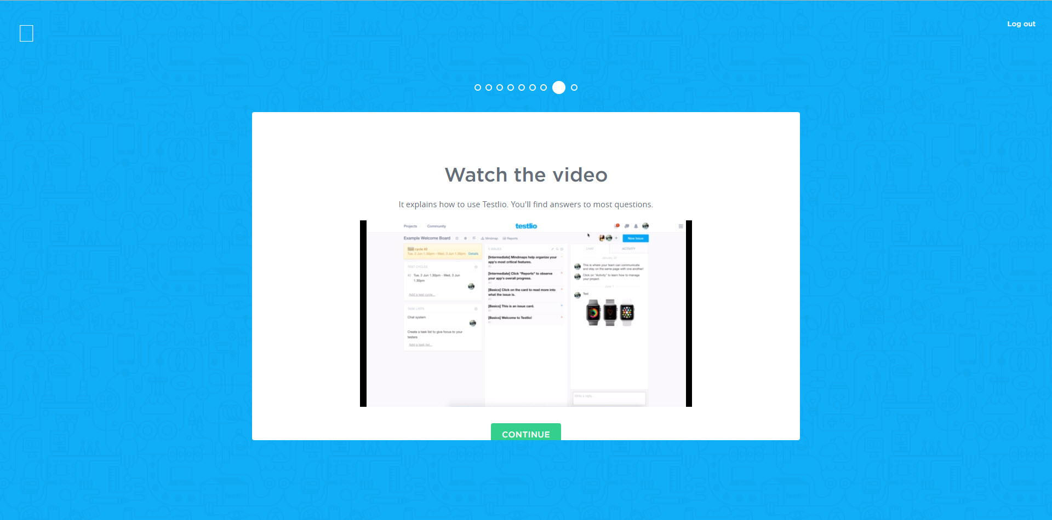
https://vimeo.com/129539889
testlio
ER BENEFITS
Notes:
Useful resources to help you get started (from Intro e-mail):
Intro video: https://vimeo.com/129539889
How to report bugs effectively: https://testlio.com/blog/kiss-method-for-bug-reporting/
Expectations of you as a tester: https://testlio.com/blog/the-10-core-values-all-expert-testers-have-in-common/

Slide 29

Ubertesters
What’s Ubertesters?
The perfect tool for QA Managers
An easy way to get paid for testing
The best platform to gather the beta testing team
Notes:
What's Ubertesters?
The perfect tool for QA Managers: Track all testing sessions in real-time using the Ubertesters dashboard. Distribute builds to your team members over-the-air. Create distribution groups for A/B testing of your iOS and Android apps. Get a real picture of testers work and review testers’ activity videos. Improve your app based on test-cases execution results, beta testers’ feedbacks, crashes and detailed issues reports. Manage the builds for enhanced security and export the issues to the most popular bug-tracking-systems.
An easy way to get paid for testing: If you’re a skilled and talented QA professional who is excited about testing new products and reporting their flaws you should become a part of the Ubertesters community of testers. Receive new products for real life testing using your own device from the comfort of your own home. Report bugs with edited screenshots and video sessions recording directly from the tested app. Become part of their freelance software tester community and get paid for your efforts.
The best platform to gather the beta testing team: Thousands of inquisitive minds are ready to look at your product and test it on any real device used by your clients. Transparent flat rates for all types of projects, no matter if you require exploratory testing or test cases execution. Create a scalable beta team by request including an experienced assigned project manager. No testers limits per task, apps type, location or project. Review results of your tester’s activity and communicate with us 24/7 for better time-to-market of a quality product.

Slide 30

https://ubertesters.com/become-tester/
Ubertesters
Become a Tester
Complete a short form
Get certified
Test apps & earn money
Let’s become a tester…
Notes:
Join the Uber League of Testers!
Become an Ubertester, earn money, and test pre-released amazing mobile apps and exciting games from the leading mobile developers around the world, and all in your spare time.
- Amazing projects from global brands
- Career opportunity - work hard and become a team-lead with your own team
- Get paid for the time spent on testing - every hours counts
- Flexible schedule - test apps in your spare time
Complete a short form - Tell us about yourself and your technical skills
Get certified - One of our managers will contact you shortly to complete the certification process
Test apps & earn money - Be the first who tests amazing apps from global brands. Do it in your spare time and earn money.

Slide 31
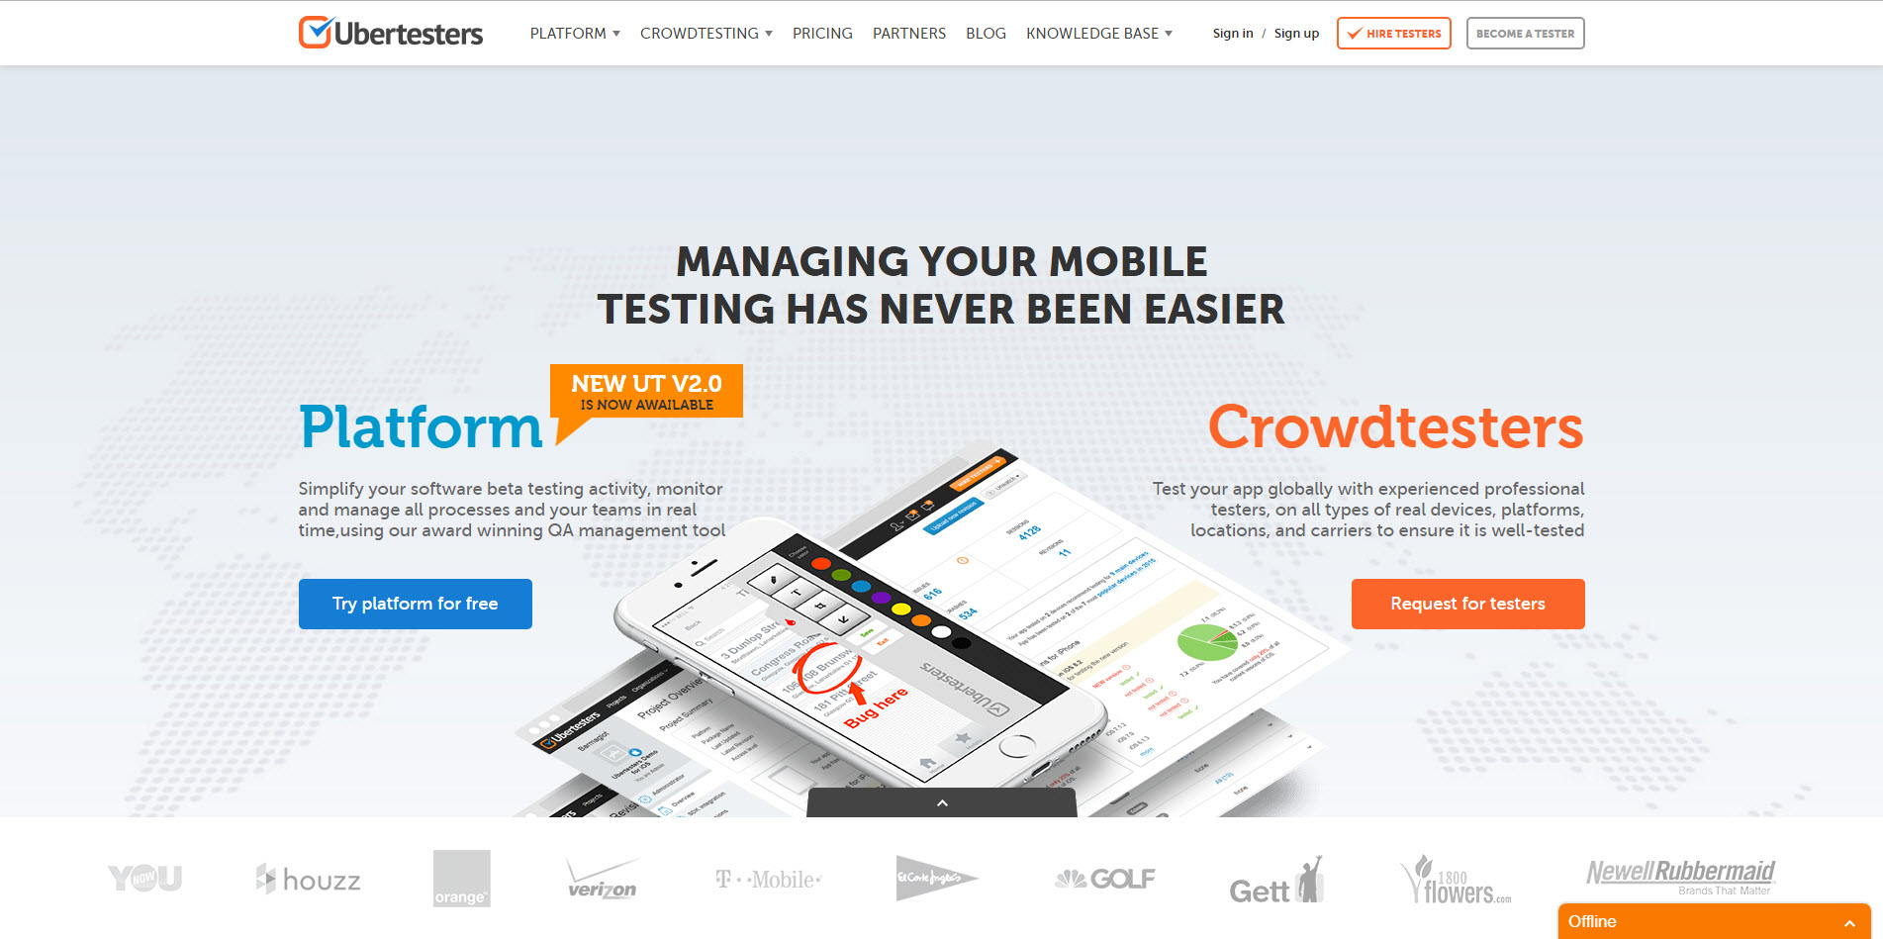
https://ubertesters.com/
Ubertesters
ER BENEFITS
Notes:
Managing your mobile testing has never been easier.
Platform – Simplify your software beta testing activity, monitor and manage all processes and your teams in real time, using our award winning QA management tool.
Crowdtesters - Test your app globally with experienced professional testers, on all types of real devices, platforms, locations, and carriers to ensure it is well-tested.
Click the BECOME A TESTER button.

Slide 32
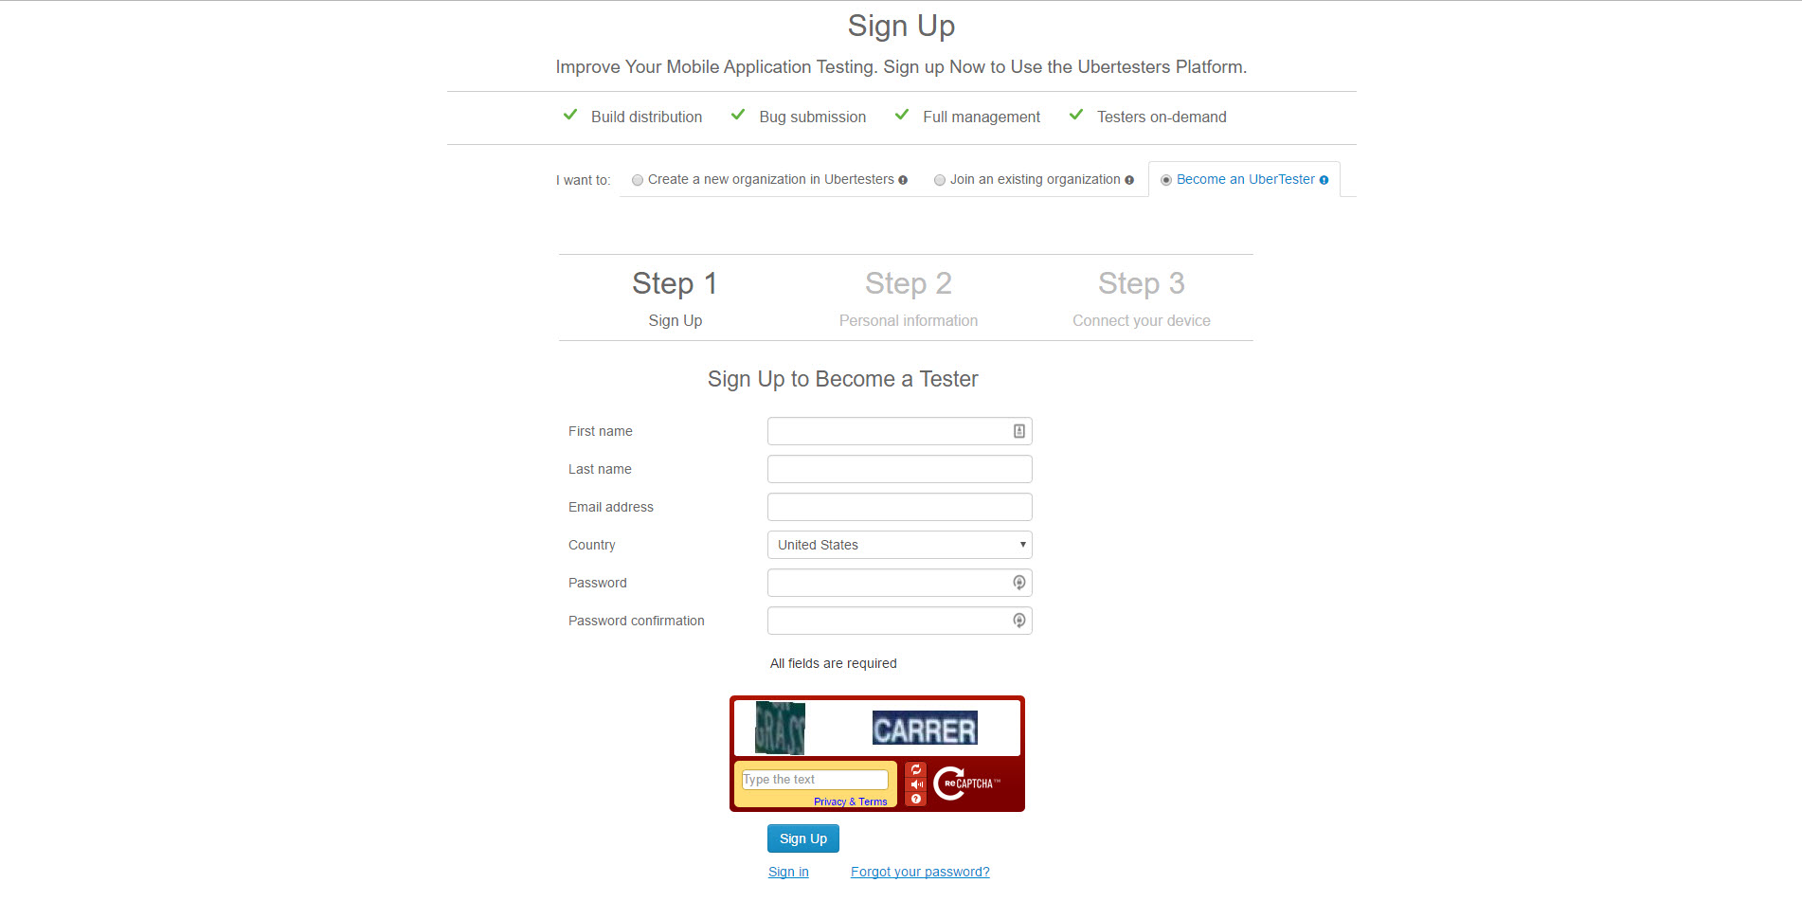
Ubertesters
ER BENEFITS
Notes:
Step 1 – Sign Up

Slide 33
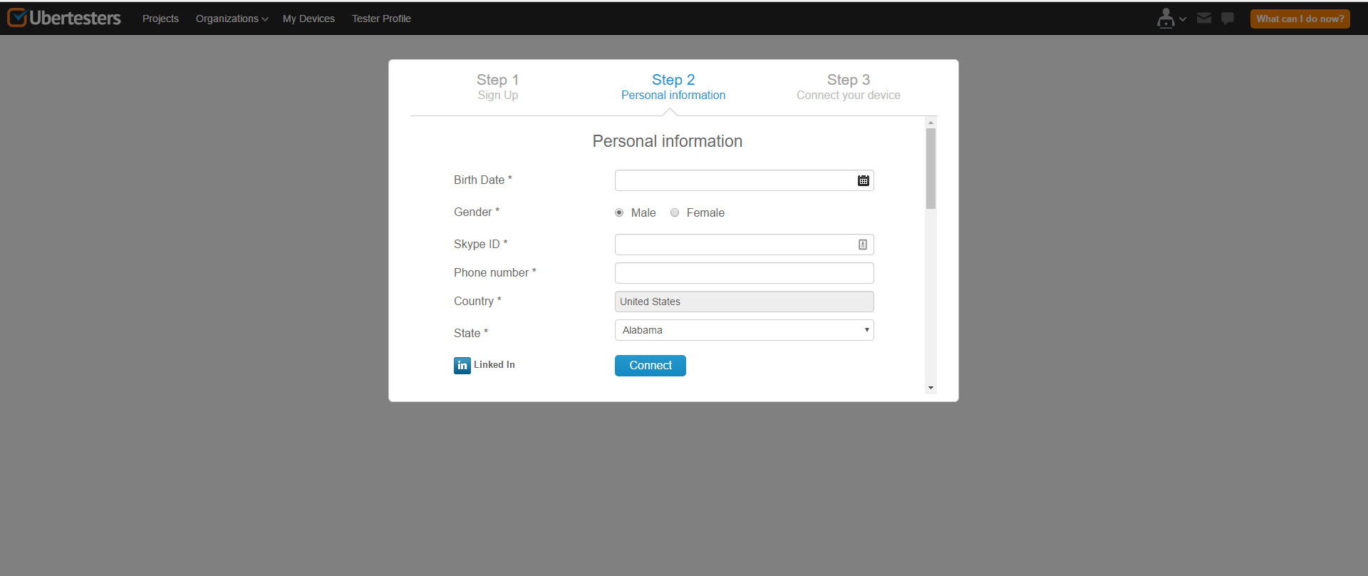
Ubertesters
ER BENEFITS
Notes:
Step 2 – Personal information

Slide 34
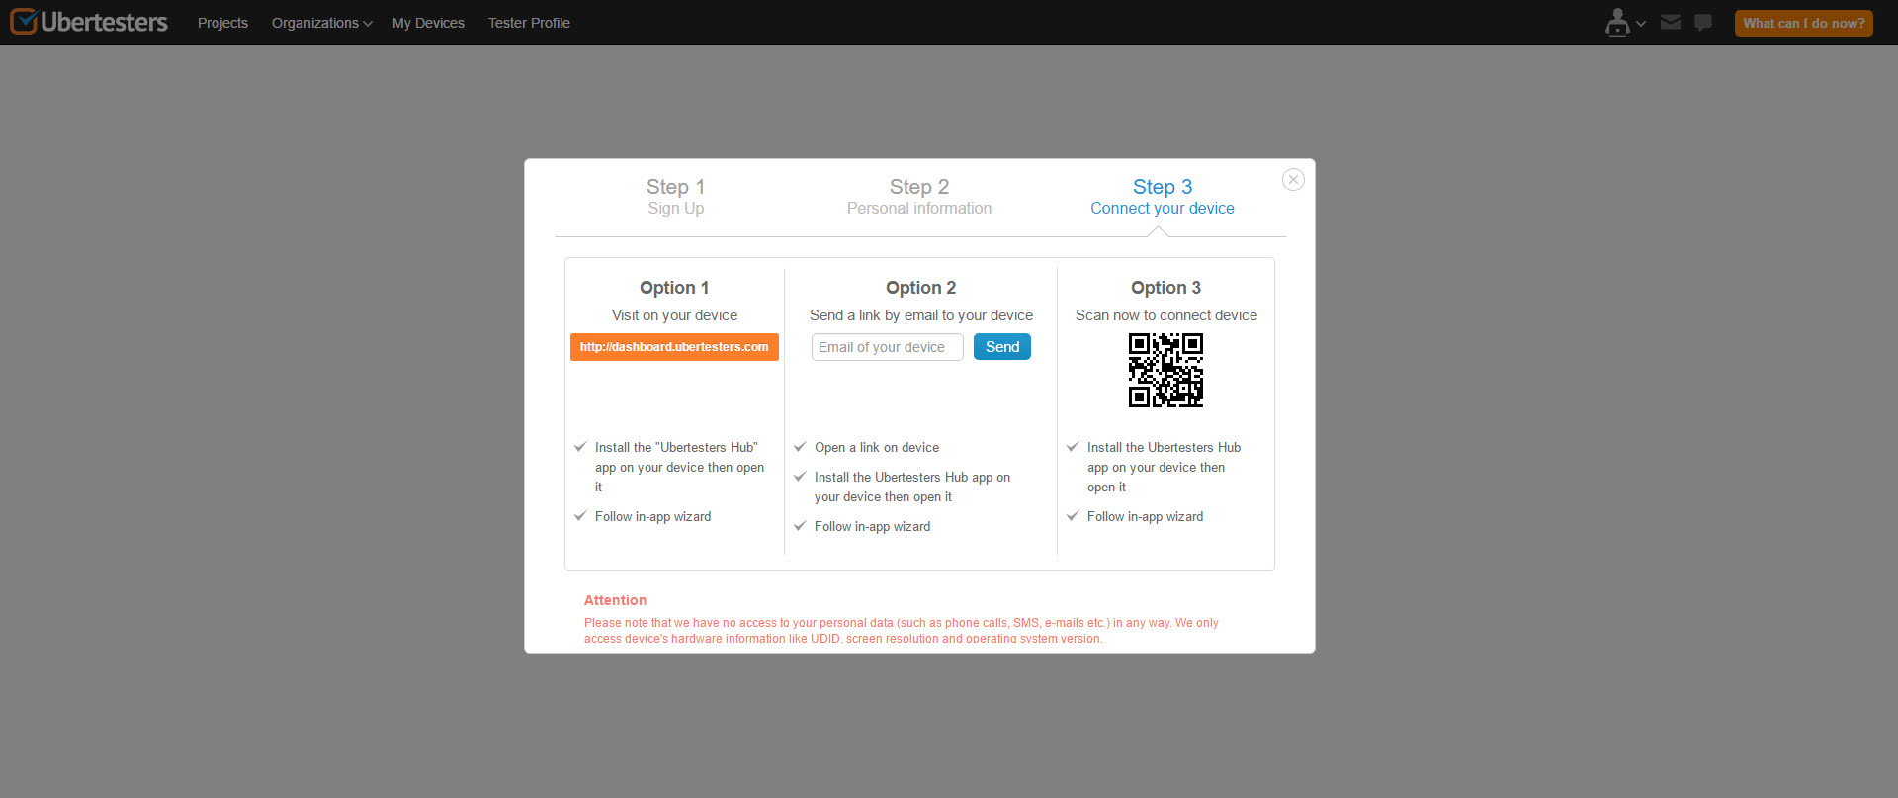
Ubertesters
ER BENEFITS
Notes:
Step 3 – Connect your device
***I’ve successfully connected my Android device, as well as 3 browsers—Chrome, Firefox, and Edge***

Slide 35
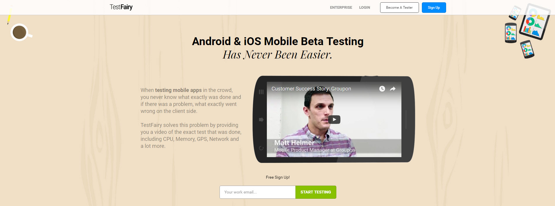
https://testfairy.com/
TestFairy
Demo: youtube.com/watch?v=uqWBPEtSPIM
Notes:
Android & iOS Mobile Beta Testing Has Never Been Easier.
When testing mobile apps in the crowd, you never know what exactly was done and if there was a problem, what exactly went wrong on the client side. TestFairy solves this problem by providing you a video of the exact test that was done, including CPU, Memory, GPS, Network and a lot more.
Click the Become A Tester button.

Slide 36

Feeling like this?

Slide 37

Are you unappreciated?

Slide 38

Change Your View

Slide 39
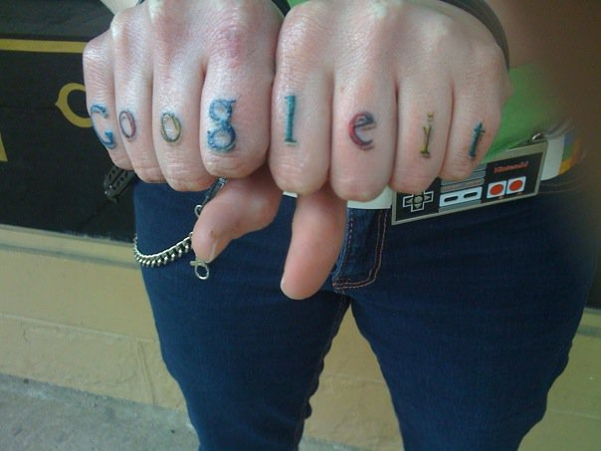
Questions?

Slide 40

Contact
E-mail: dustyjuhl@gmail.com
GitHub: dustyjuhl
LinkedIn: dustyjuhl
Twitter: @DustyJuhl

